Slide 1
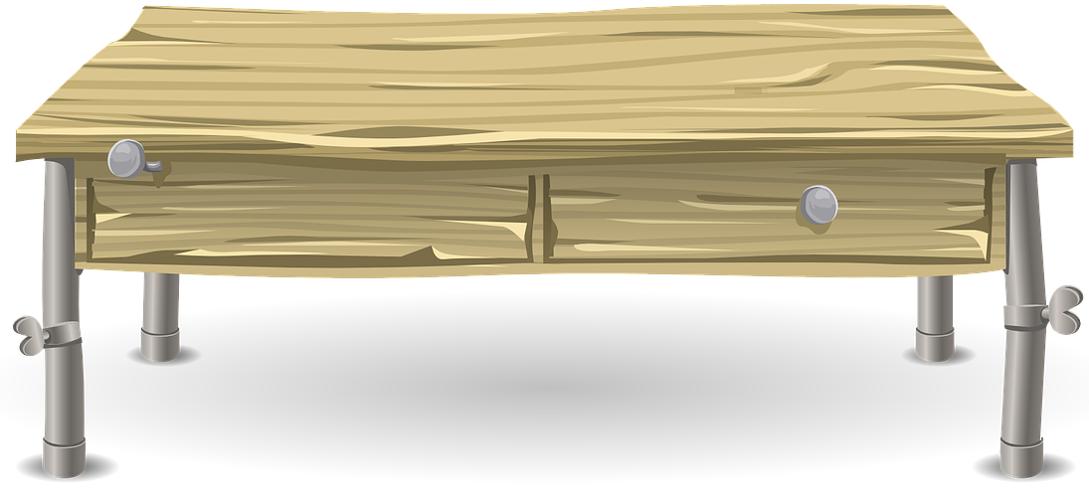
WELCOME TO MR. NASH’S CLASSROOM!
wnash@hempsteadschools.org

